Slide 1
Hooking - Keyloggers
Part 2

Slide 2
Processing data entered via the keyboard in Windows
To describe the process – from a key being pressed on the keyboard to the keyboard system interrupt controller being activated and an active WM_KEYDOWN message appearing, three sources have been usedL
“Apparatnoe obeshpechenie IBM PC” by Alexander Frolov and Grigory Frolov, Volume 2, Book 1. Published by Dialog-MIFI, 1992. The second chapter, “The Keyboard” described how a keyboard functions, the ports used, and keyboard hardware interrupts;
The section related to “HID / Human Input Devices” of the MSDN library, which describes the low-level (driver) part of the process by which keyboard input is processed;
Jeffrey Richter’s book ‘Creating effective Win32 applications for 64-bit Windows”. Chapter 27, “A model of hardware input and the local input condition” contains a description of the high level part of the process by which keyboard input is processed (in user mode).

Slide 3
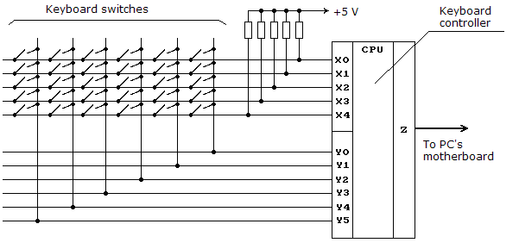
The keyboard as a physical device: how it works

Slide 4
Low-level interaction with the keyboard via the input/ output port
In order to read data entered via the keyboard, one only has to be able to read the values of input/ output port 60h and 64h. However, user-level applications in Windows are unable to work with ports; this function is fulfilled by operating system drivers.

Slide 5
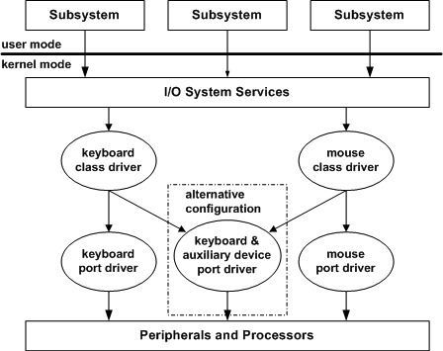
Driver stack for system input devices

Slide 6
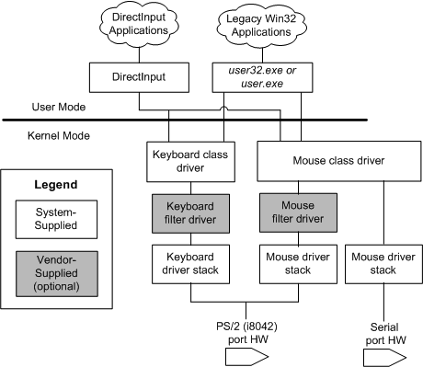
Driver stack for Plug and Play PS/2 keyboards

Slide 7
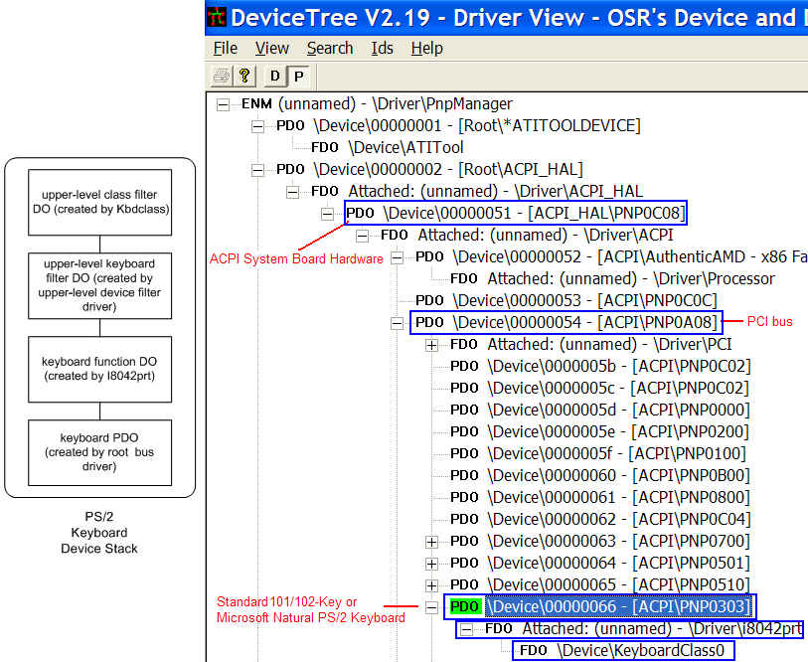
Device stack for Plug and Play PS/2 keyboards

Slide 8
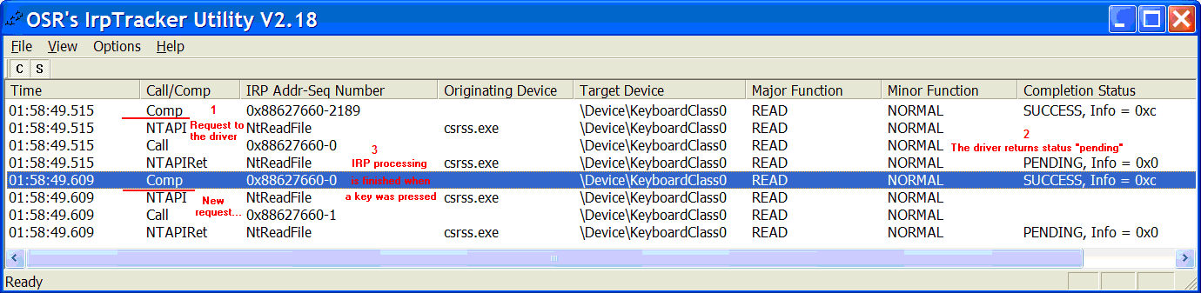
Raw input thread (data received from the driver)

Slide 9
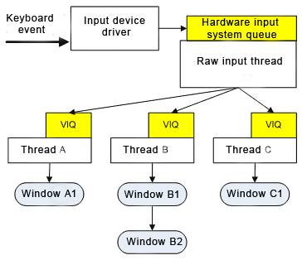
Processing keyboard input in user mode

Slide 10
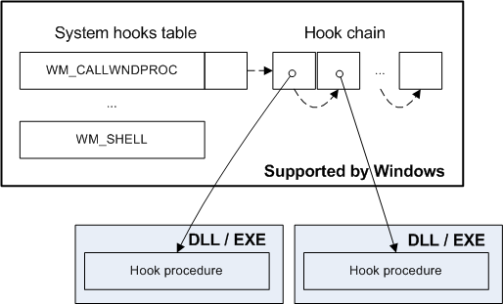
Keyboard hooks

Slide 11
Implementing keyloggers: the variants
Implementing Keyloggers.docx

Slide 12
Python Program

